Slide 1
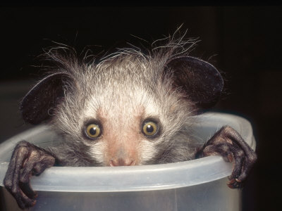
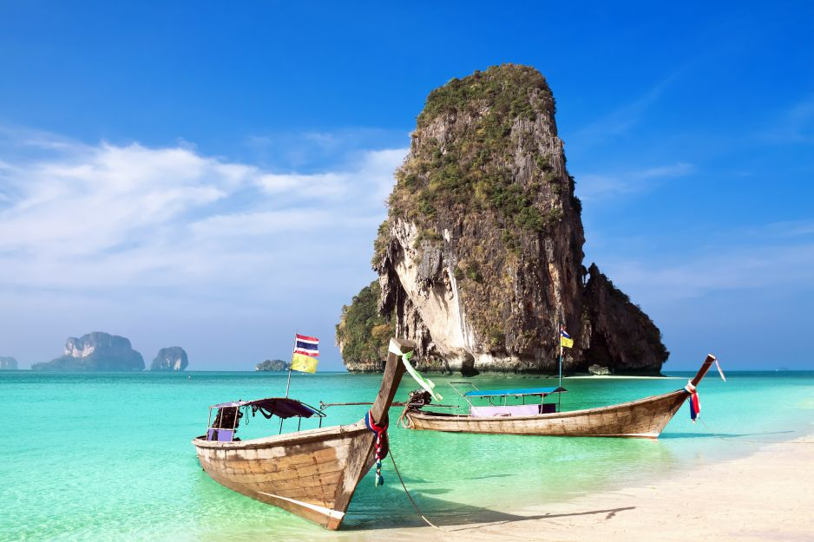
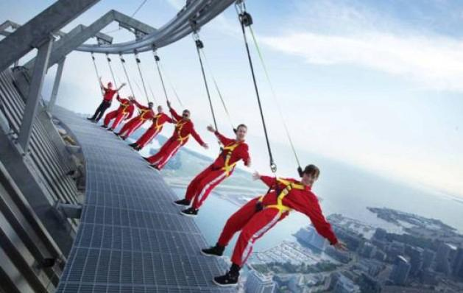
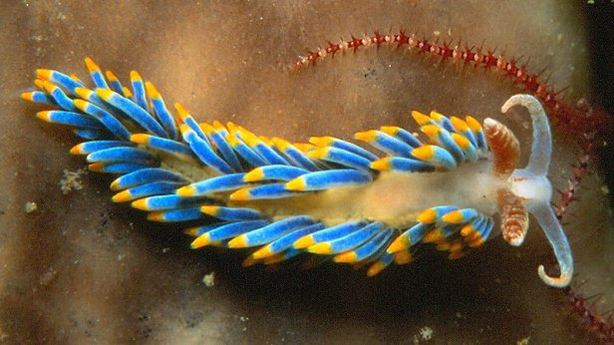
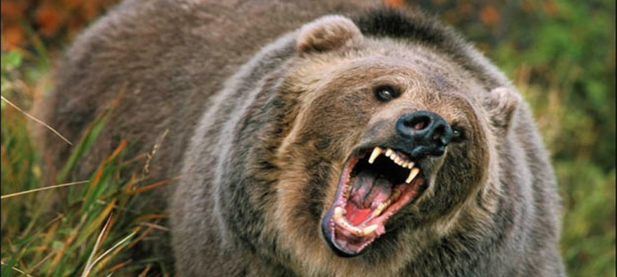
Amazing animals and places all around the world

Slide 2
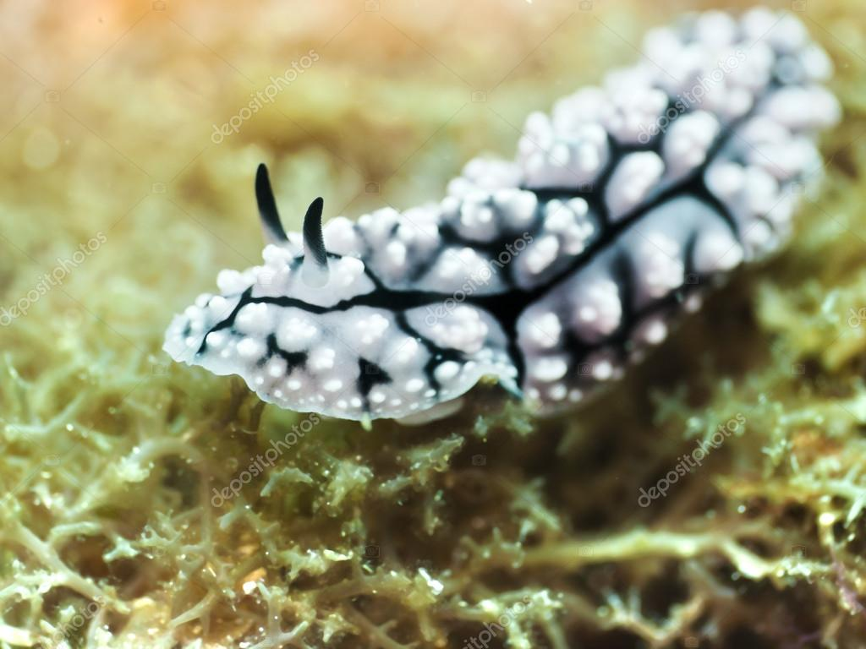
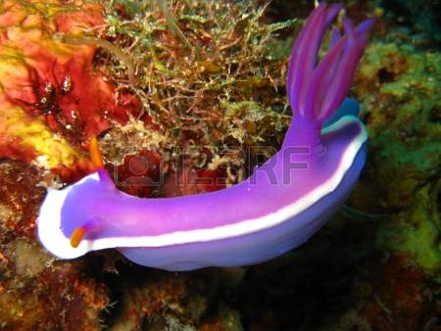
Slug opisthobranchia
Slugs opisthobranchia - are a large group of snails. They are colurful marine creatures. They have at least a single pair of tentacles which they cannot withdraw. Slugs have a reduced or absent shell.

Slide 3
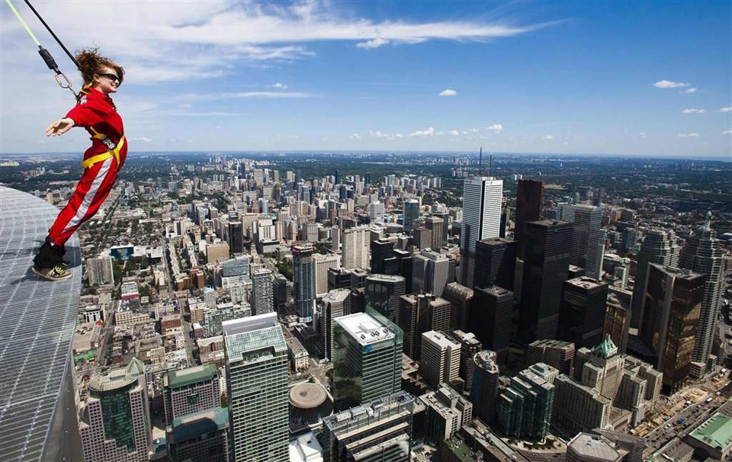
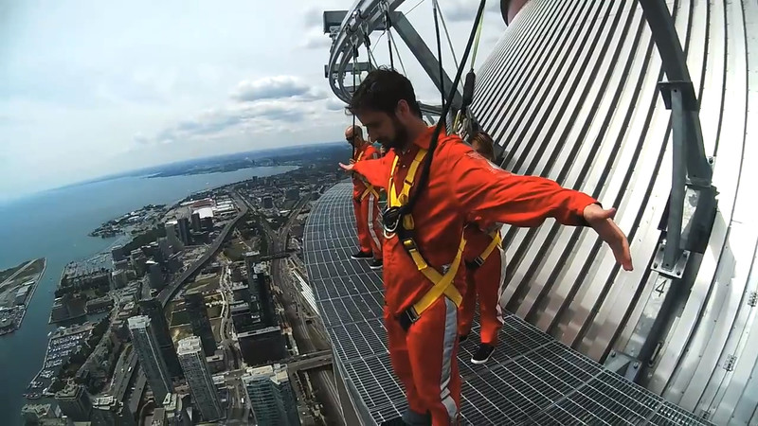
CN Tower in Toronto
CN Tower in Toronto - one of Canada’s greatest landmarks and one of the seven wonders of the modern world, the CN Tower has come to define the Toronto skyline. At 553 metres in height, this engineering wonder is hard to miss during any trip through the city.

Slide 4
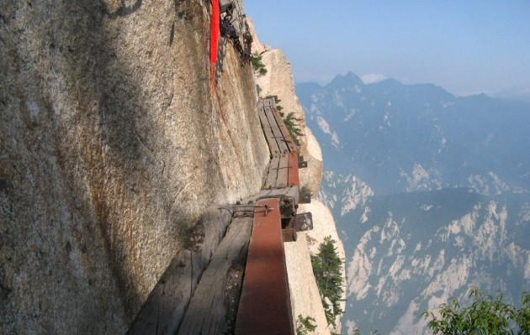
Mountain Huashan
Mountain Huashan - it is famous for steep and narrow paths, precipitous crags and a high mountain range. Hike on Huashan Mountain is very popular among visitors.

Slide 5
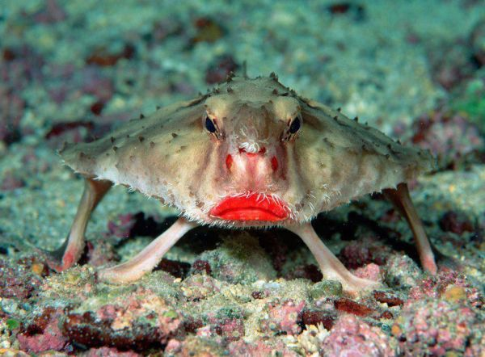
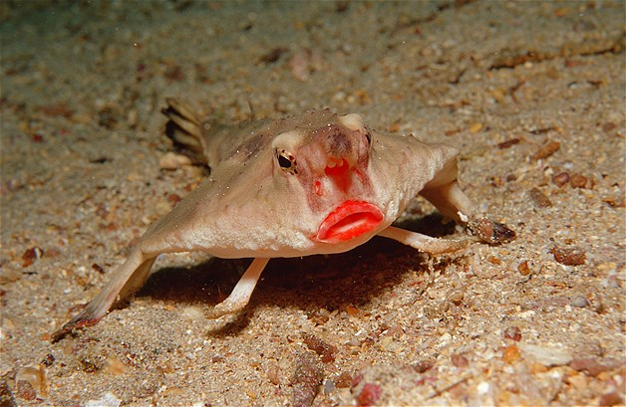
Red-Lipped Batfish
Red-Lipped Batfish – the weirdest fish. They are bottom-dwelling deep sea lovers, and are called batfish because of their flattened bodies. The red-lipped batfish has stylish bright red lips. They are pretty fabulous. Red-lipped batfish live on the sea floor near that ecological wonder, the Galapagos Islands.

Slide 6
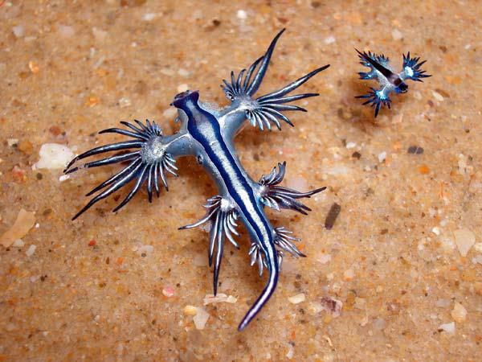
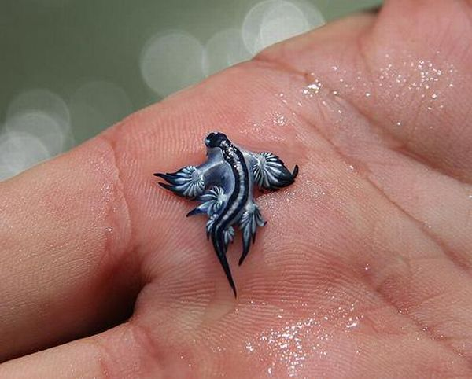
Blue dragon
Blue dragon- is the most beautiful sea slug. It’s actually not all that different from our average garden snail, just a lot more colorful… and often extremely poisonous. The blue dragon can grow to about one and half metres in length!

Slide 7
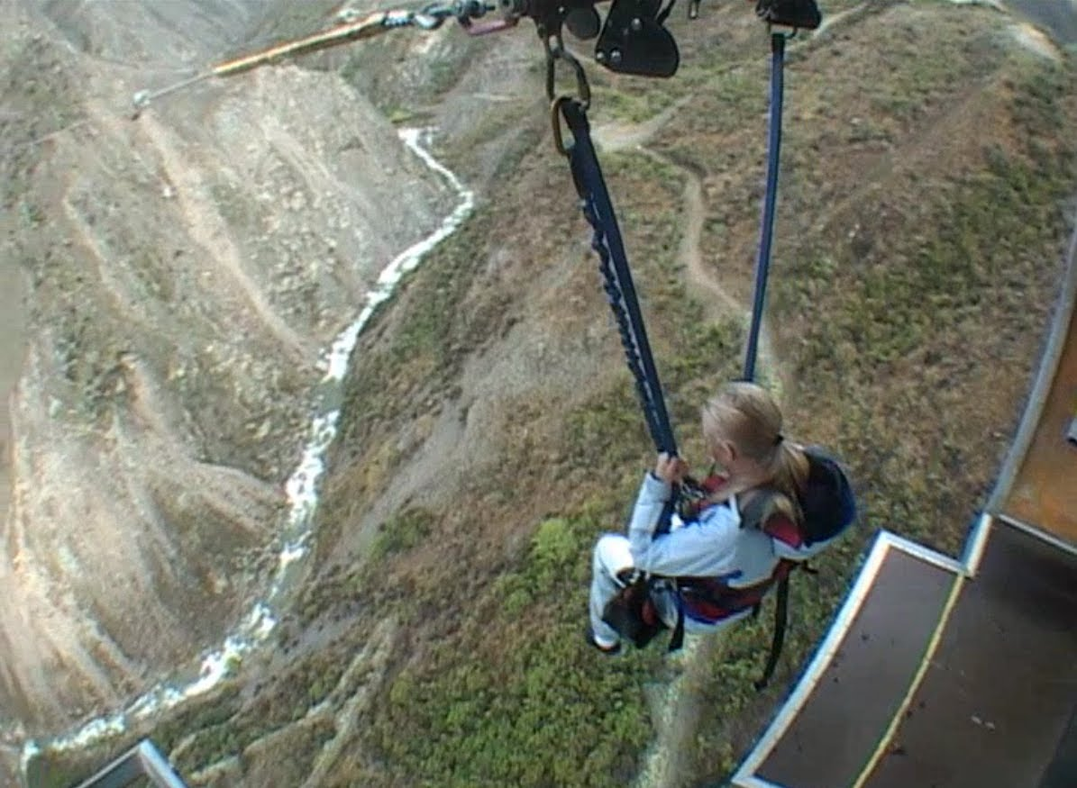
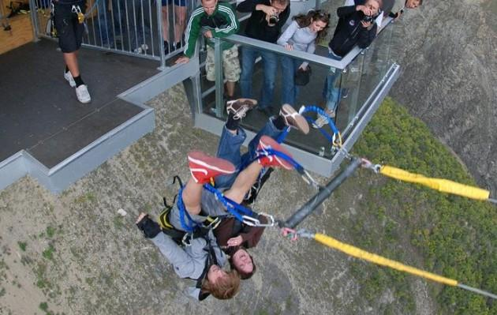
Nevis Swing
Nevis Swing - The World's Biggest Swing is located next to the Nevis Bungy and is a 40 minute drive from central Queenstown.
It is suspended 160 metres above the canyon floor.

Slide 8
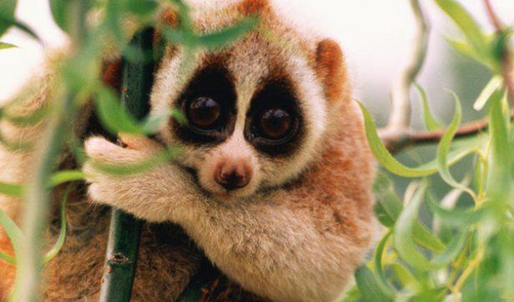
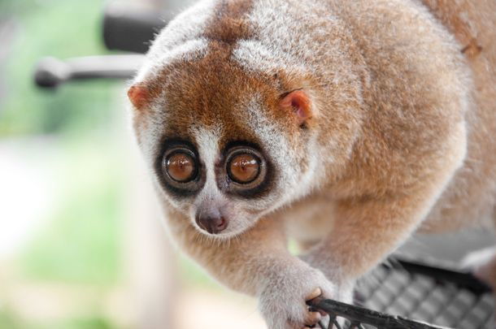
Prosimian lori
Prosimian lori-is one of the most adorable animals in the world.
It is found in different parts of Southeast Asia. Lories sleep during the day, curled up like a ball in hidden parts of trees above ground. They eat ants and other insects. Although lorises are unbelievably cute, they do not make good pets. They exude a toxin from their elbows which they deliver by biting.

Slide 9
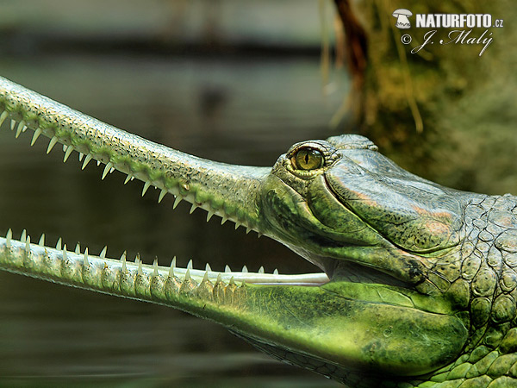
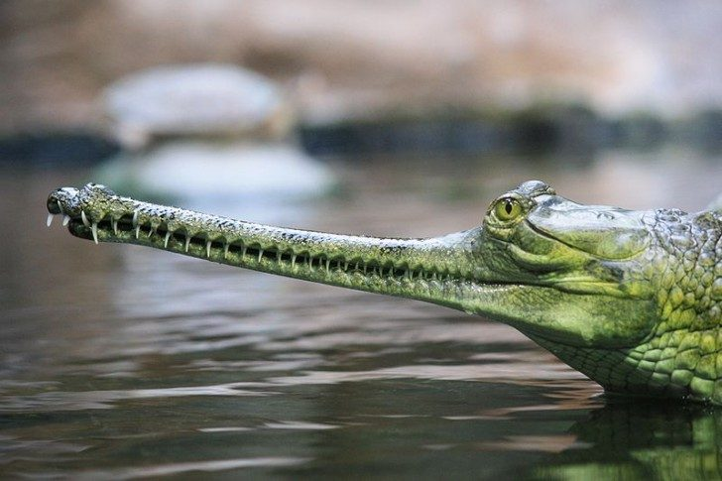
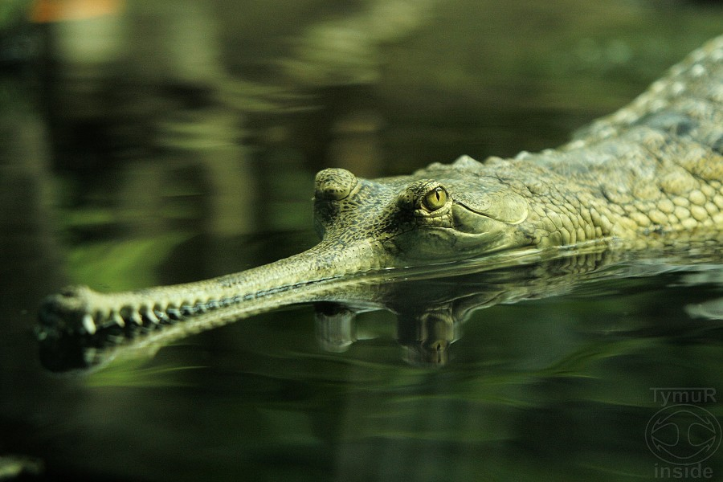
Gharial
Gharials - they are a group of crocodile-like reptiles with long, narrow jaws. The gharial has 27 to 29 upper and 25 or 26 lower teeth on each side. The gharial is the second-longest of all living crocodilians: a large male can be nearly six meters in length. Gharials live in rivers. They are best adapted to the calmer areas in deep fast moving rivers. They eat insects, larvae, small frogs and fish. They are not a man-eater.

Slide 10
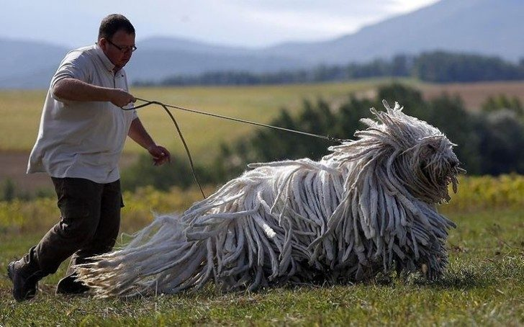
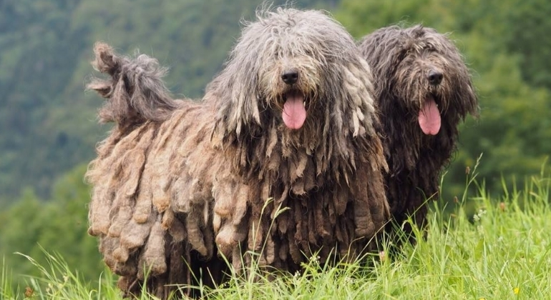
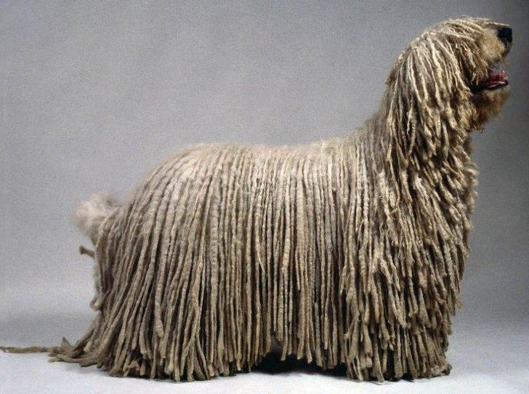
Sheepdog from Bergamo
Sheep dog is a large dog, immediately recognizable by its long, thick, shaggy grey and white coat, with fur covering their face and eyes. Sheep dogs are used to guard sheep and other livestock in farms for farmers.

Slide 11
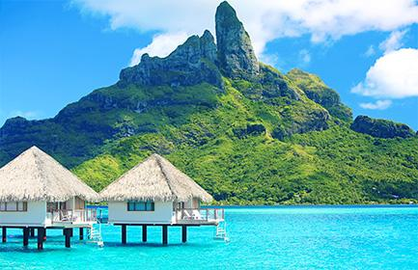
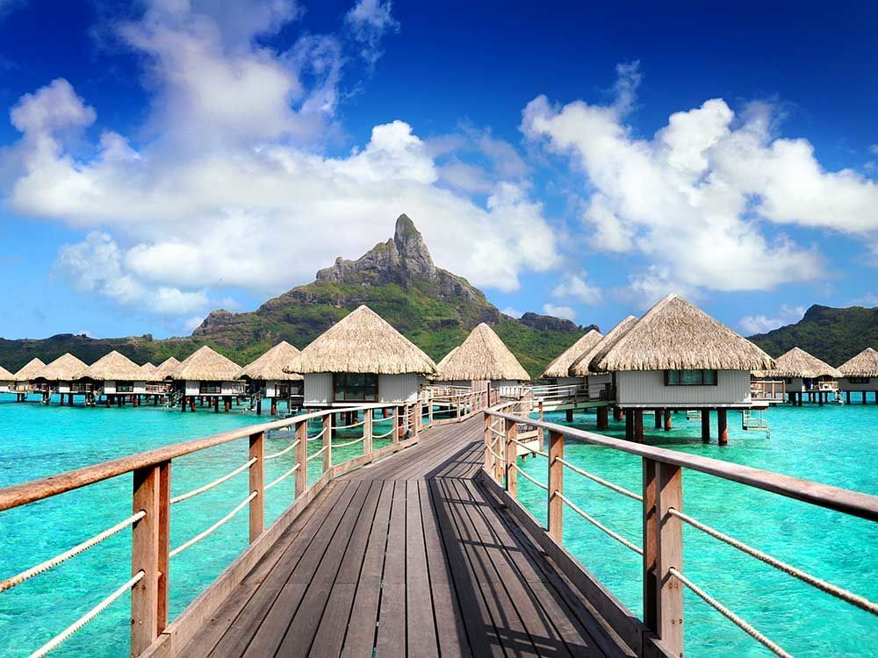
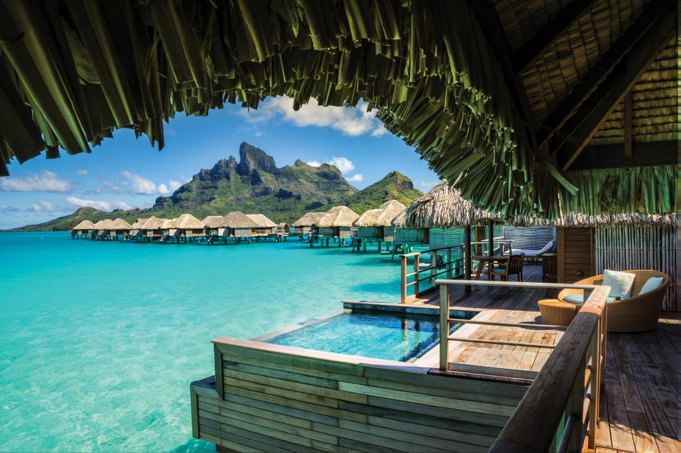
Bora Bora, French Polynesia
Bora Bora is a 30.55 km² island group in the western part of the Society Islands of French Polynesia. Bora Bora is a major international tourist destination, famous for its aqua-centric luxury resorts.

Slide 12
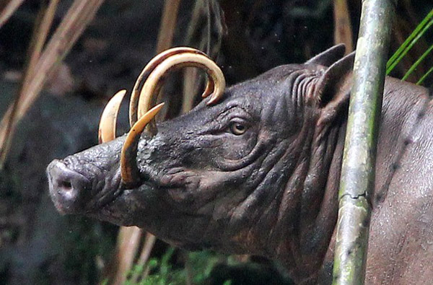
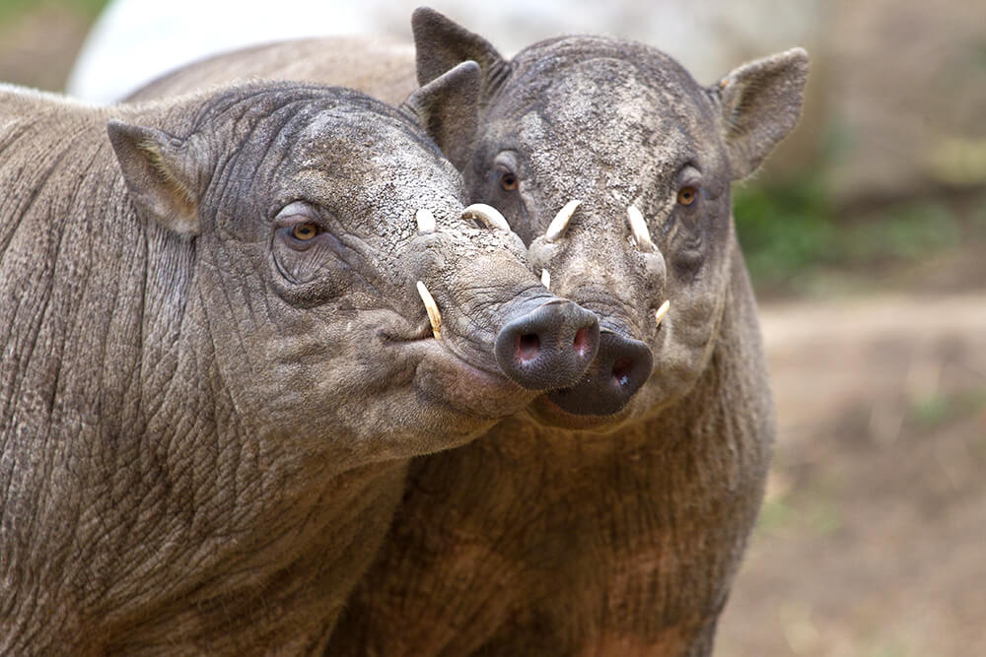
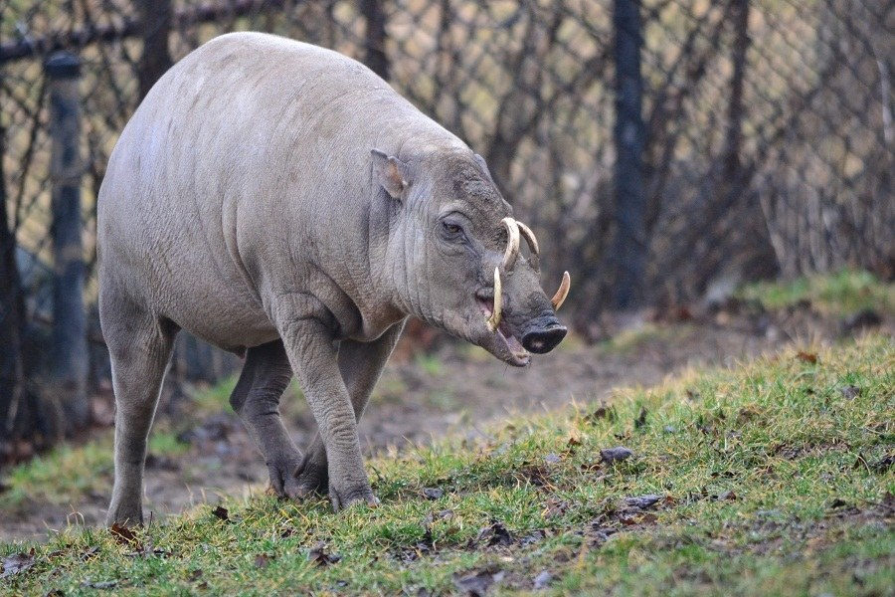
Babirusa
Babirusas are very unique pigs. Babirusas are wild members of the pig family but they differ from other pigs in several ways. They are found in the swamps and rainforests of Indonesian islands, babirusas have barrel-shaped bodies balanced on delicate, deer-like legs. They have naked body and massive, curving tusks.

Slide 13
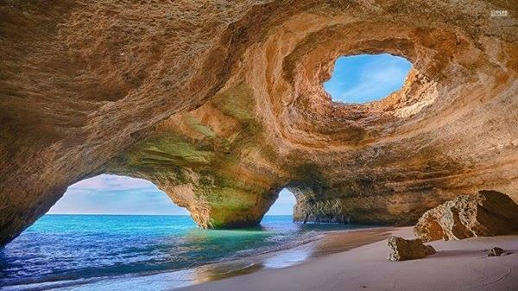
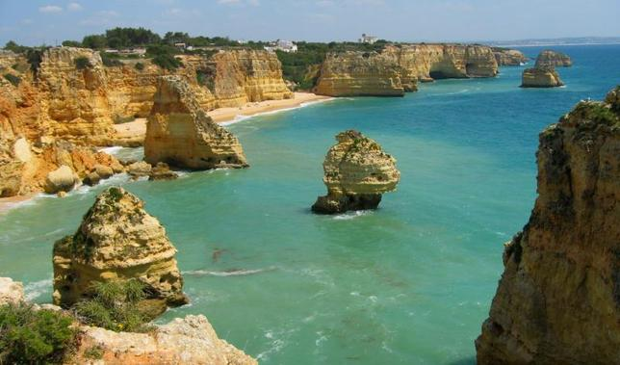
Benegil, Portugal
The Benagil caves are some of the most impressive sea caves in Europe. The Benagil caves are situated 150 meters east to the Benagil beach, Praia de Benagil. The amazing caves of this area are accessible by boat or kayak.

Slide 14
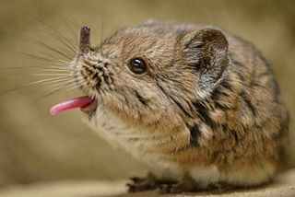
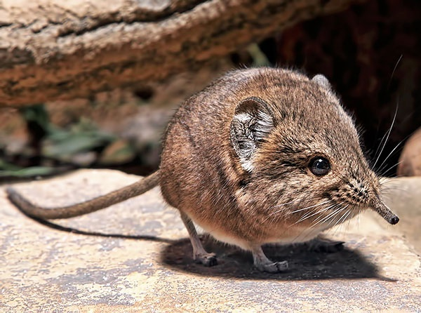
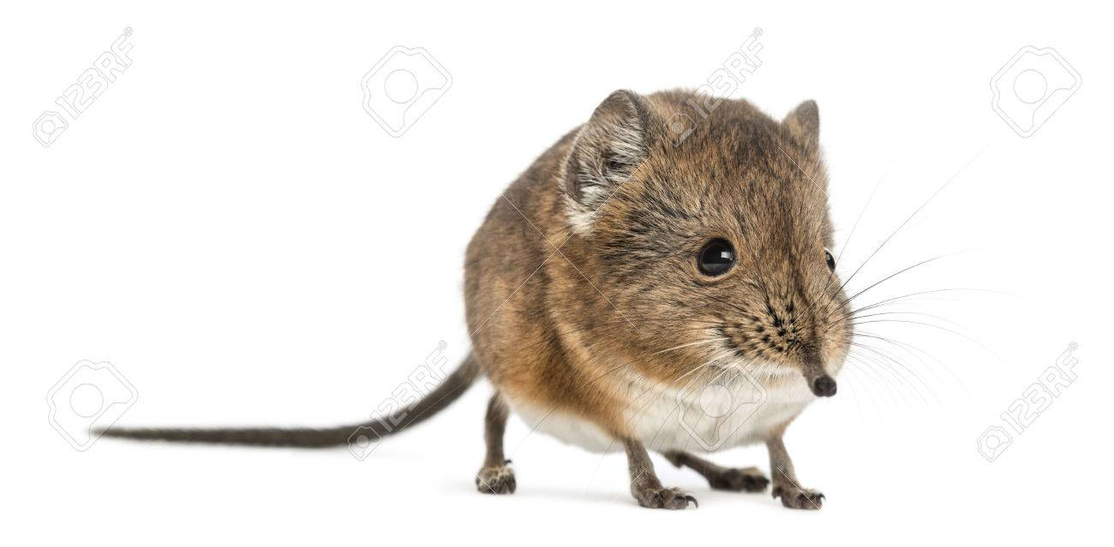
Shrews
Shrews are a small mole-like mammals. All shrews are comparatively small, most no larger than a mouse. They have sharp, spike-like teeth.

Slide 15
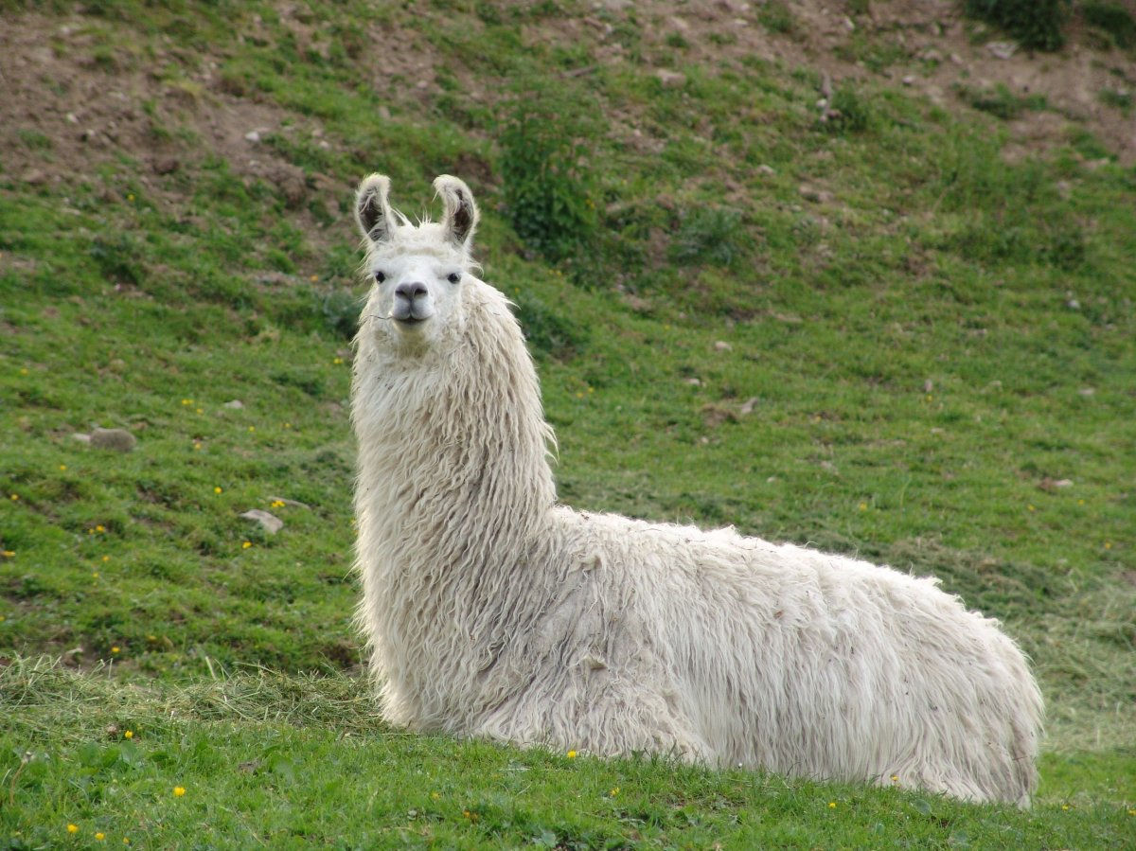
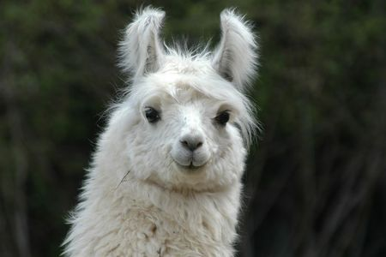
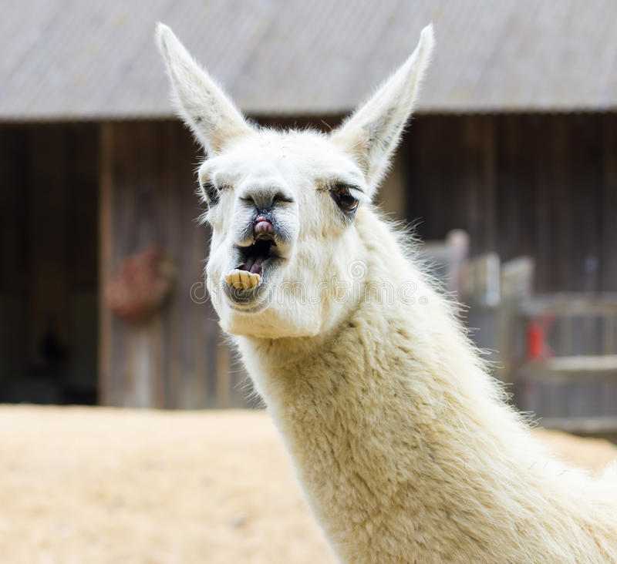
Llama
The llama is a South American relative of the camel, though the llama does not have a hump. These sturdy creatures are domestic animals used by the peoples of the Andes Mountains. Native peoples have used llamas as pack animals for centuries. Typically, they are saddled with loads of 50 to 75 pounds.

Slide 16
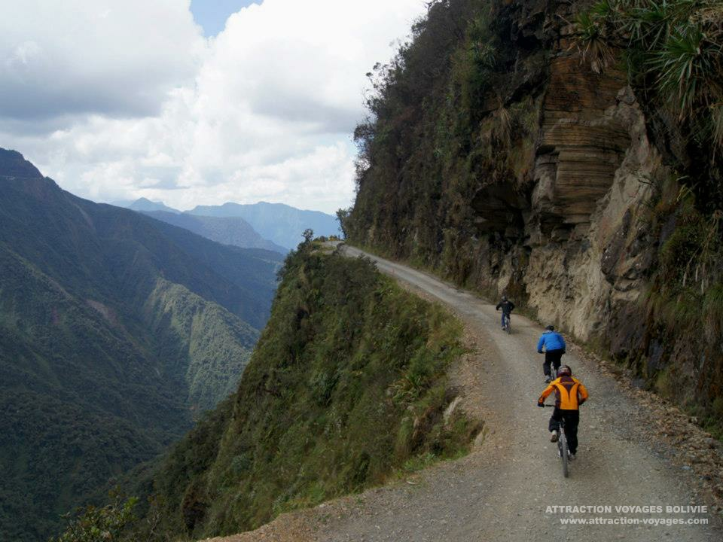
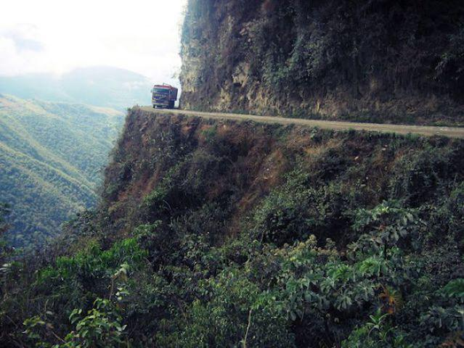
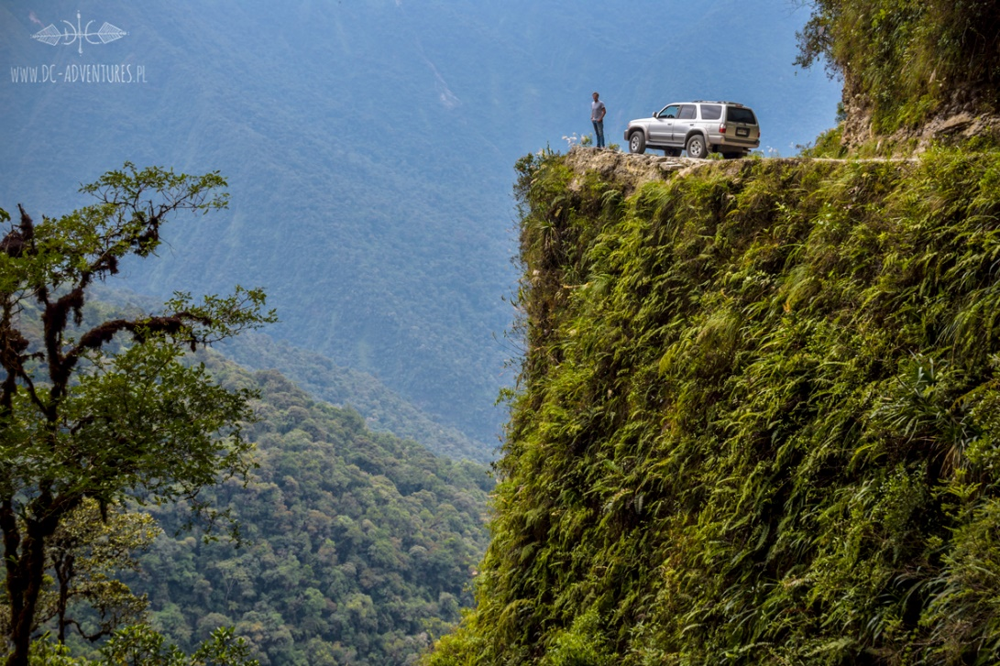
Road of the death, Bolivia
Road of Death in Bolivia - is a road leading from La Paz to Coroico, 56 kilometres northeast of La Paz in the Yungas region of Bolivia.
About 200 to 300 travellers are killed yearly along the road.

Slide 17
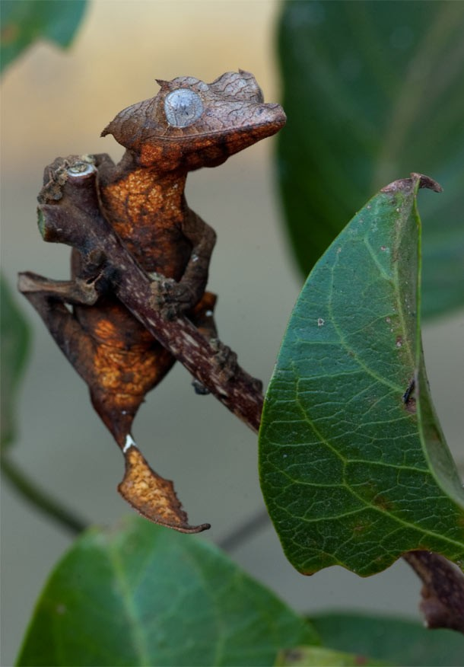
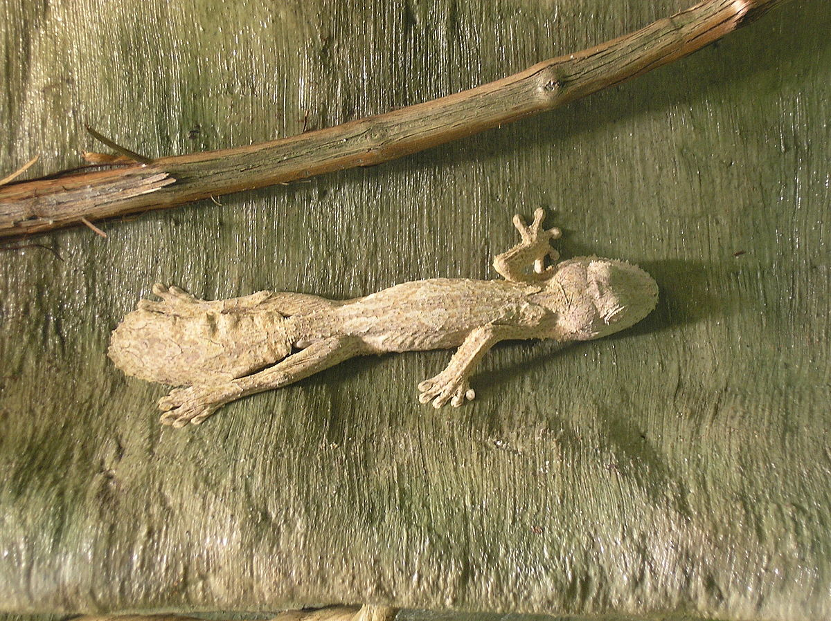
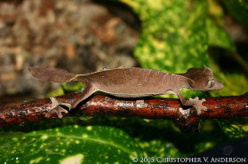
Geckos
Geckos -are lizards found in warm climates throughout the world. They range from 1.6 to 60 cm.
Most geckos cannot blink, but they often lick their eyes to keep them clean and moist.

Slide 18
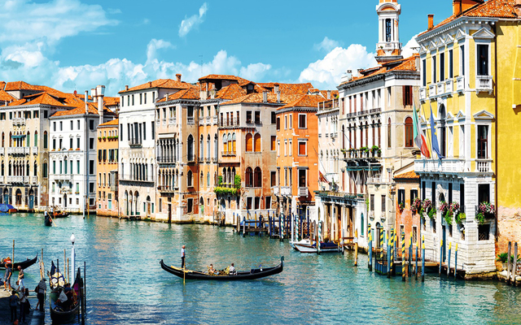
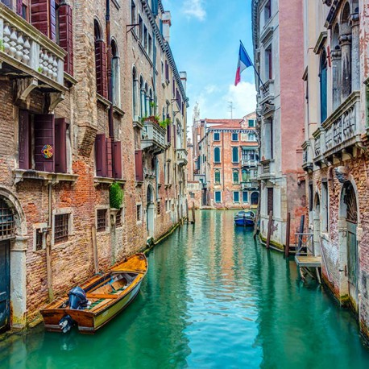
Venice
It is situated across a group of 118 small islands that are separated by canals and linked by bridges, of which there are 400.
The islands are located in the shallow Venetian Lagoon.

Slide 19
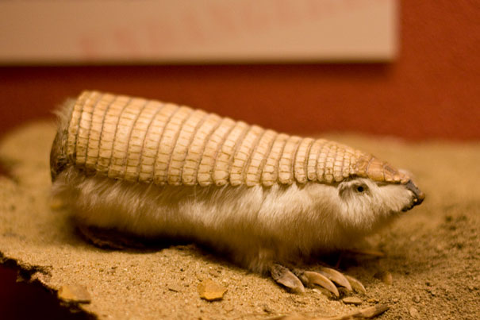
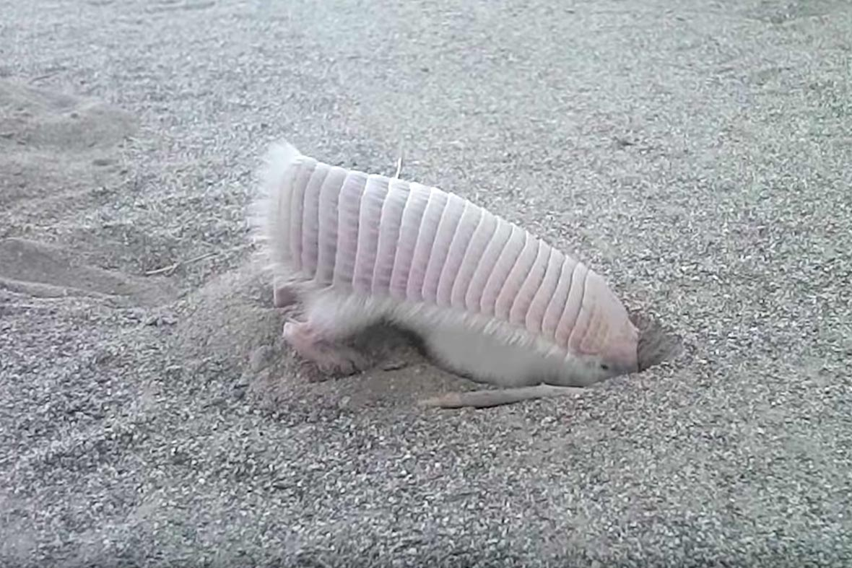
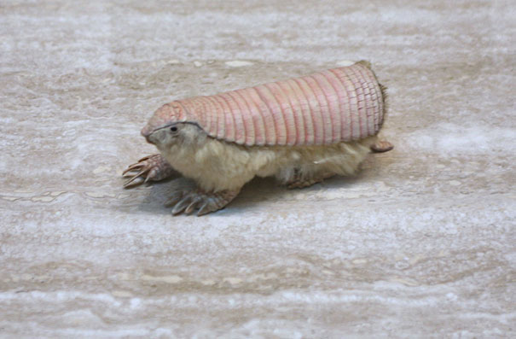
Pink Fairy Armadillo
The pink fairy armadillo is the smallest member of the armadillo family, measuring only about five to six inches in length. It is also the only armadillo in which the dorsal shell is almost separate from the body.

Slide 20
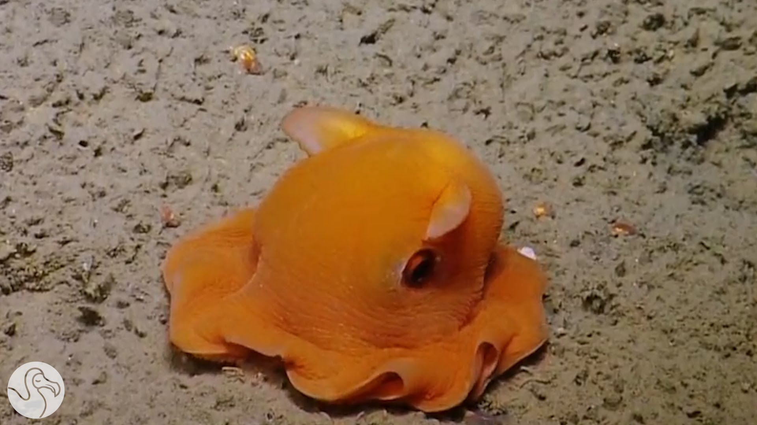
Dumbo Octopus
The dumbo octopus (Grimpoteuthis) is a deep sea animal that lives on the ocean floor at extreme depths of 9,800 to 13,000 feet. They are small animals, around 8 inches tall, and have a pair of fins located on their mantle.

Slide 21
Authors:
Source:
Maria Urban
Kinga Głowacka
Google Graphic
Wikipedia
Bored Panda

Slide 22
Thank you for attention!

