Slide 1
Look deep into nature, and then you will understand everything better

Slide 2
Do you understand these words?
Look deep into nature, and then you will understand everything better.

Slide 3
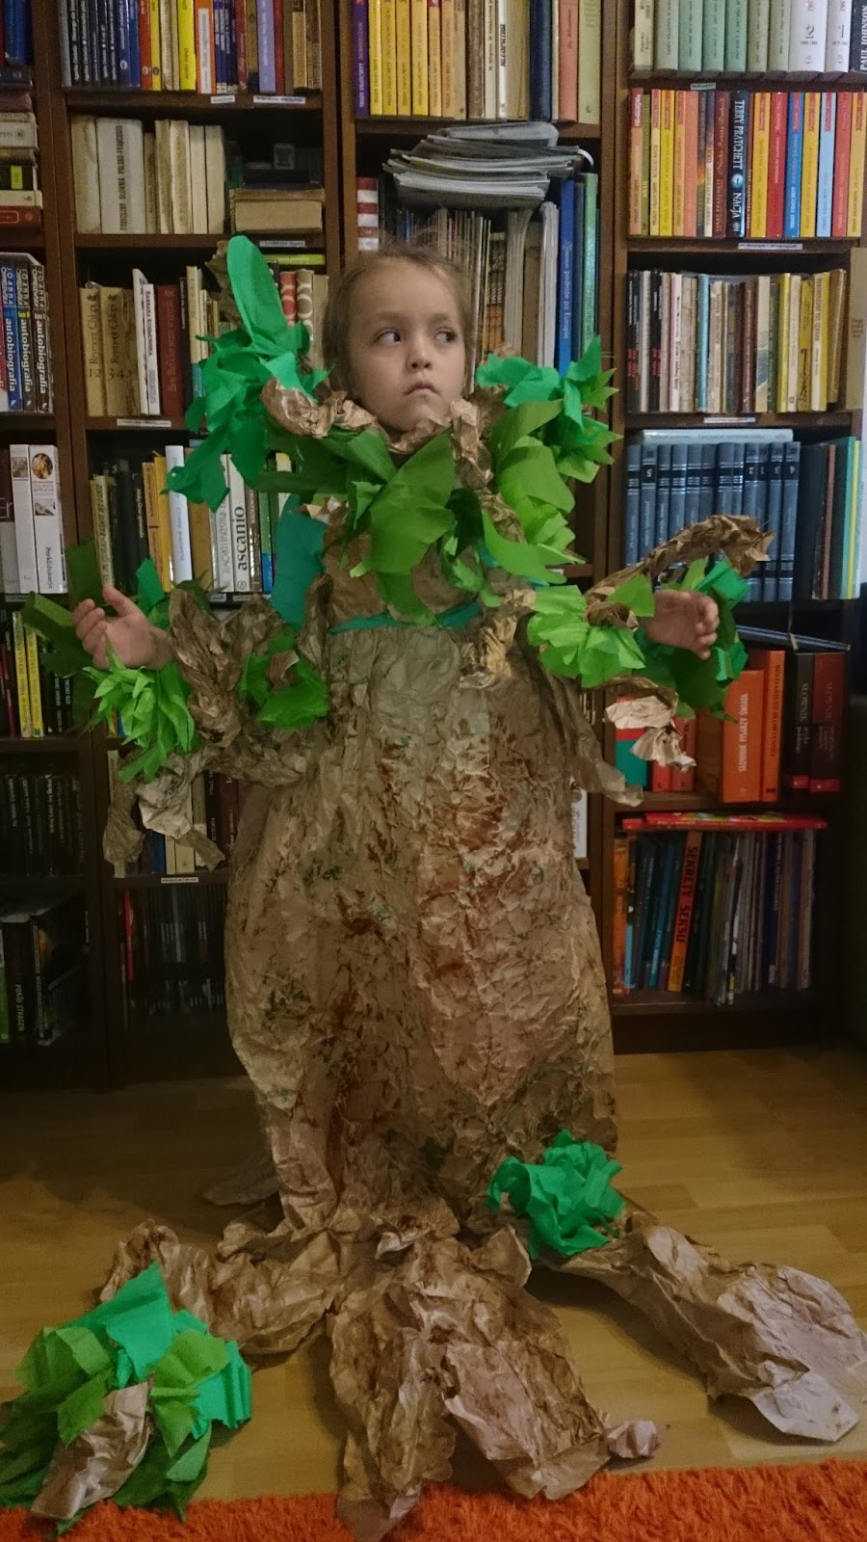
Not really

Slide 4
So, we'll check it ☺

Slide 5
Dictionary definition sounds :
Nature, in the broadest sense, is the natural, physical, or material world or universe. "Nature" can refer to the phenomena of the physical world, and also to life in general. The study of nature is ...
It sounds boring, doesn't it ?

Slide 6
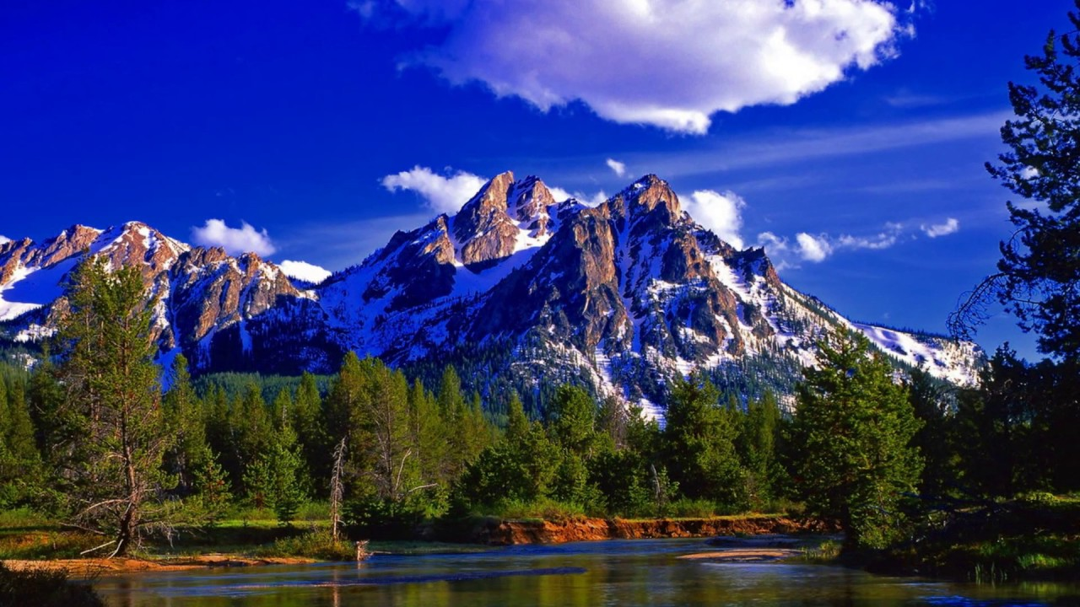
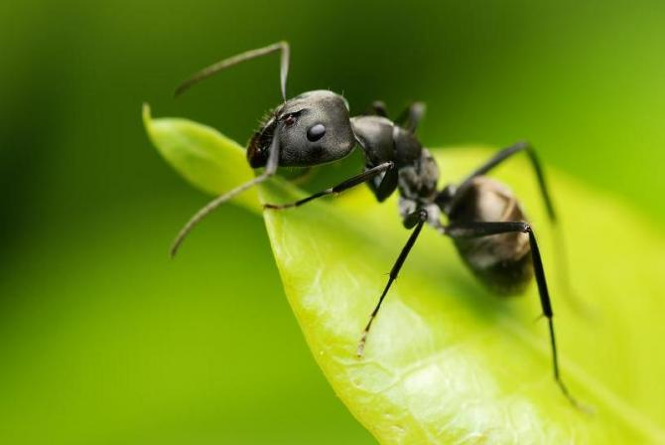
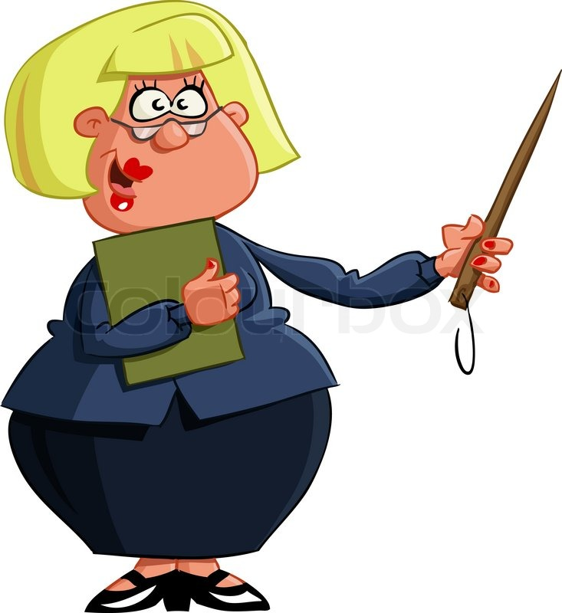
Well, what nature is for you?
Beautiful views
Awful worms
Boring biology teacher
Ecology

Slide 7
And what another people thing about nature ?
(or what they thought)

Slide 8
Let's looking for answer in the Bible.
And something in mythology.

Slide 9
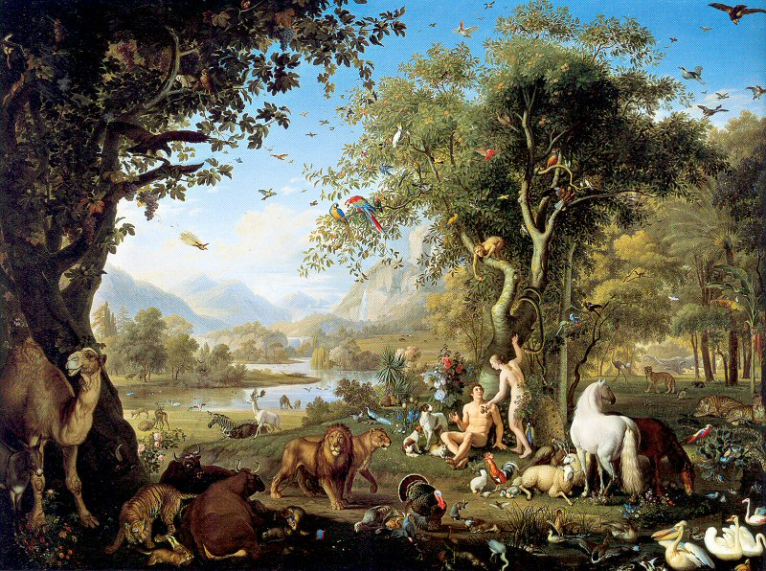
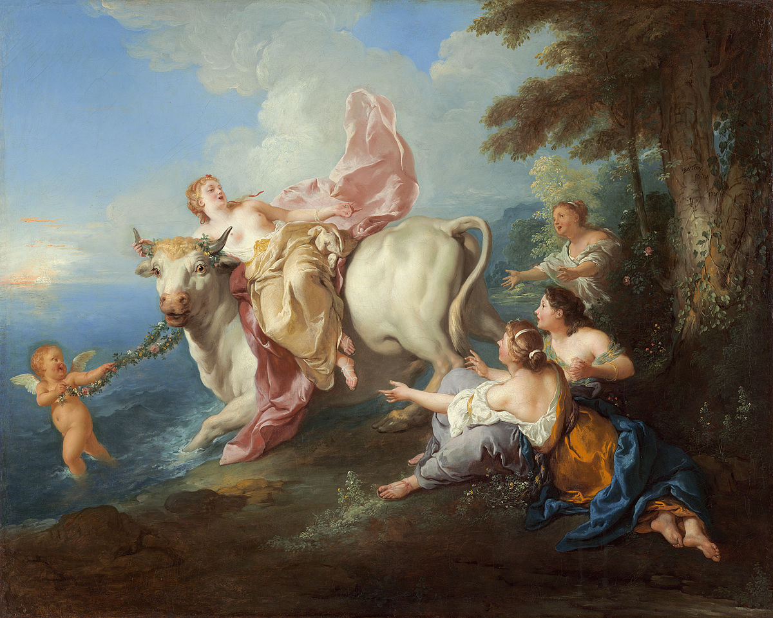
Nature in Bible and Mythology
An Eden is a biblical paradise created by God for the first people - of Adam and Ewa. In this garden people had everything and could use everything, except for the tree meaning the good and evil, of which could not pick fruits.
Mythology is also describing nature, for example: the storm, the rain, or bolts. Greeks believed that they were created by gods, which had supernatural powers.

Slide 10
What with music ?!

Slide 11
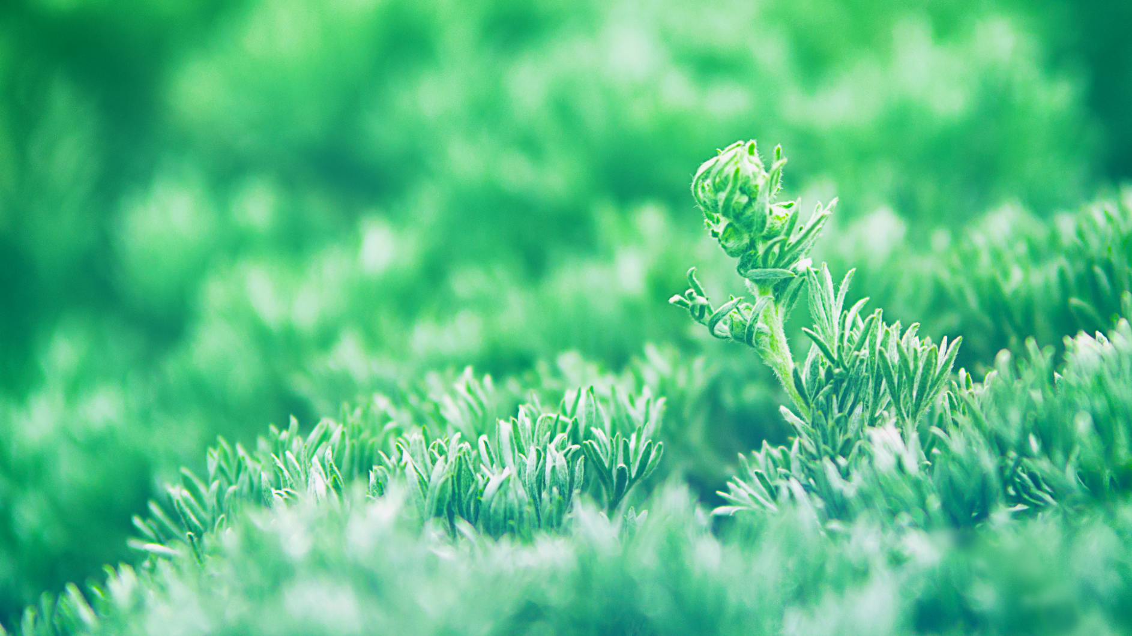
Nature in Music
In many songs we can find natural motives for example in "What a Wonderful World" of Louis Armstrong...
Or in the "We are the World" of Michael Jackson:
We are the world, We are the children We are the ones who make a brighter day So, let's start giving...

Slide 12
Hmm... who wrote that?
''Guest, sit beneath my leaves and rest at ease! The sun will not reach you here, I promise, Even if it truly soars, and straight beams Draw the scattered shadows under the trees.''

Slide 13
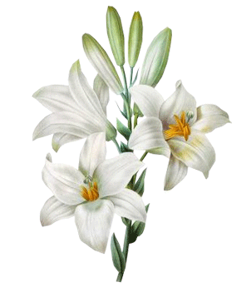
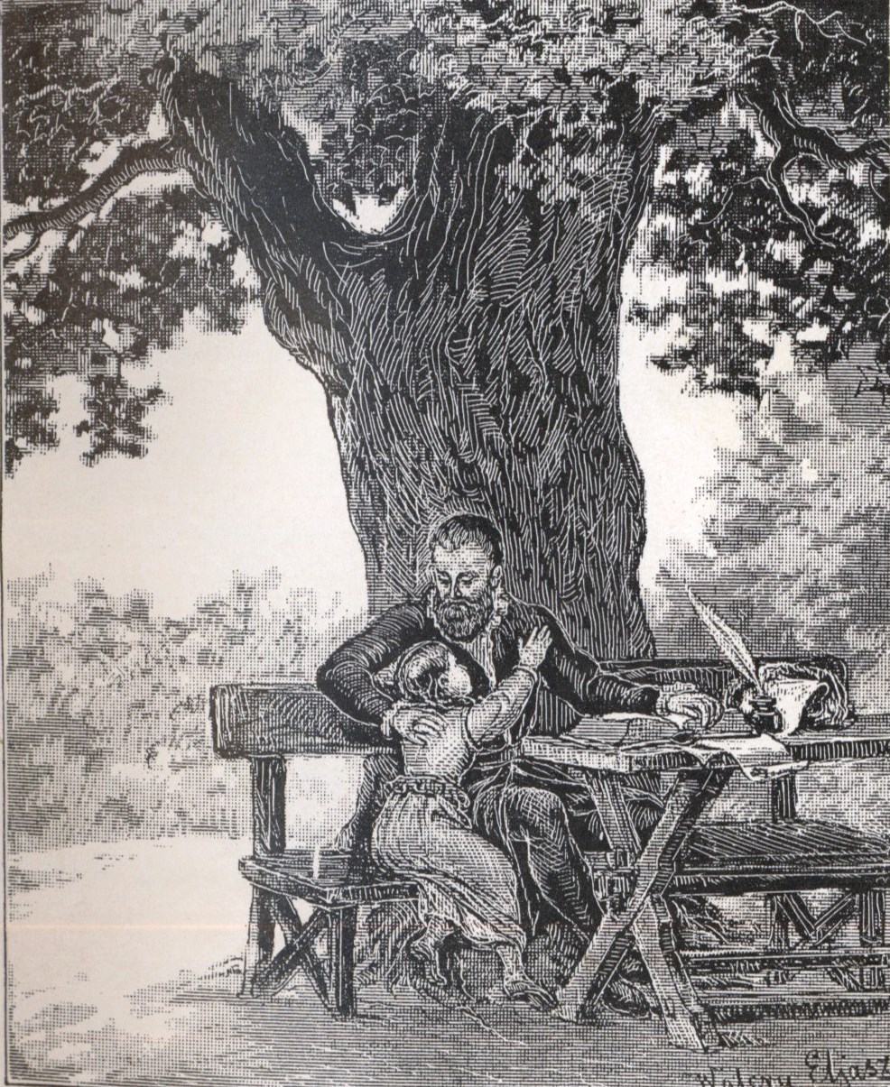
Of course, that it was Jan Kochanowski
Also Adam Mickiewicz refered to nature in his art. The best example is his ''Lilies".
But not only Kochanowski loved nature.

Slide 14
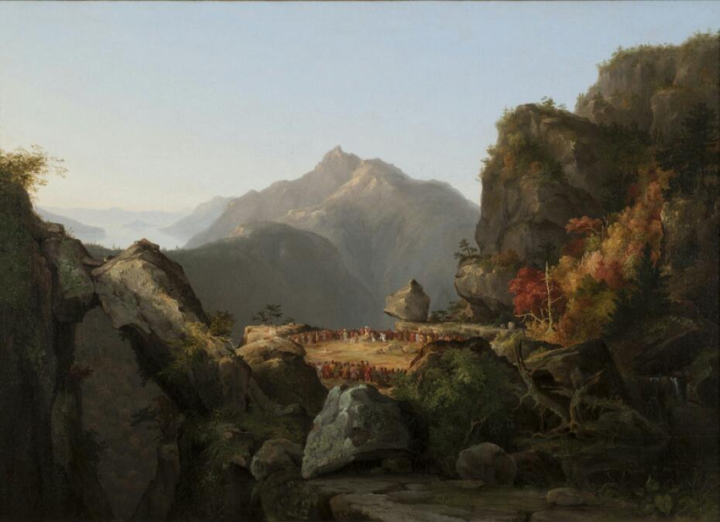
Nature in films
„The Last of the Mohicans” is a 1992 American epic historical drama film set in 1757 during the French and Indian War. In the background beautiful landscapes of America are shown - Appalachians.

Slide 15
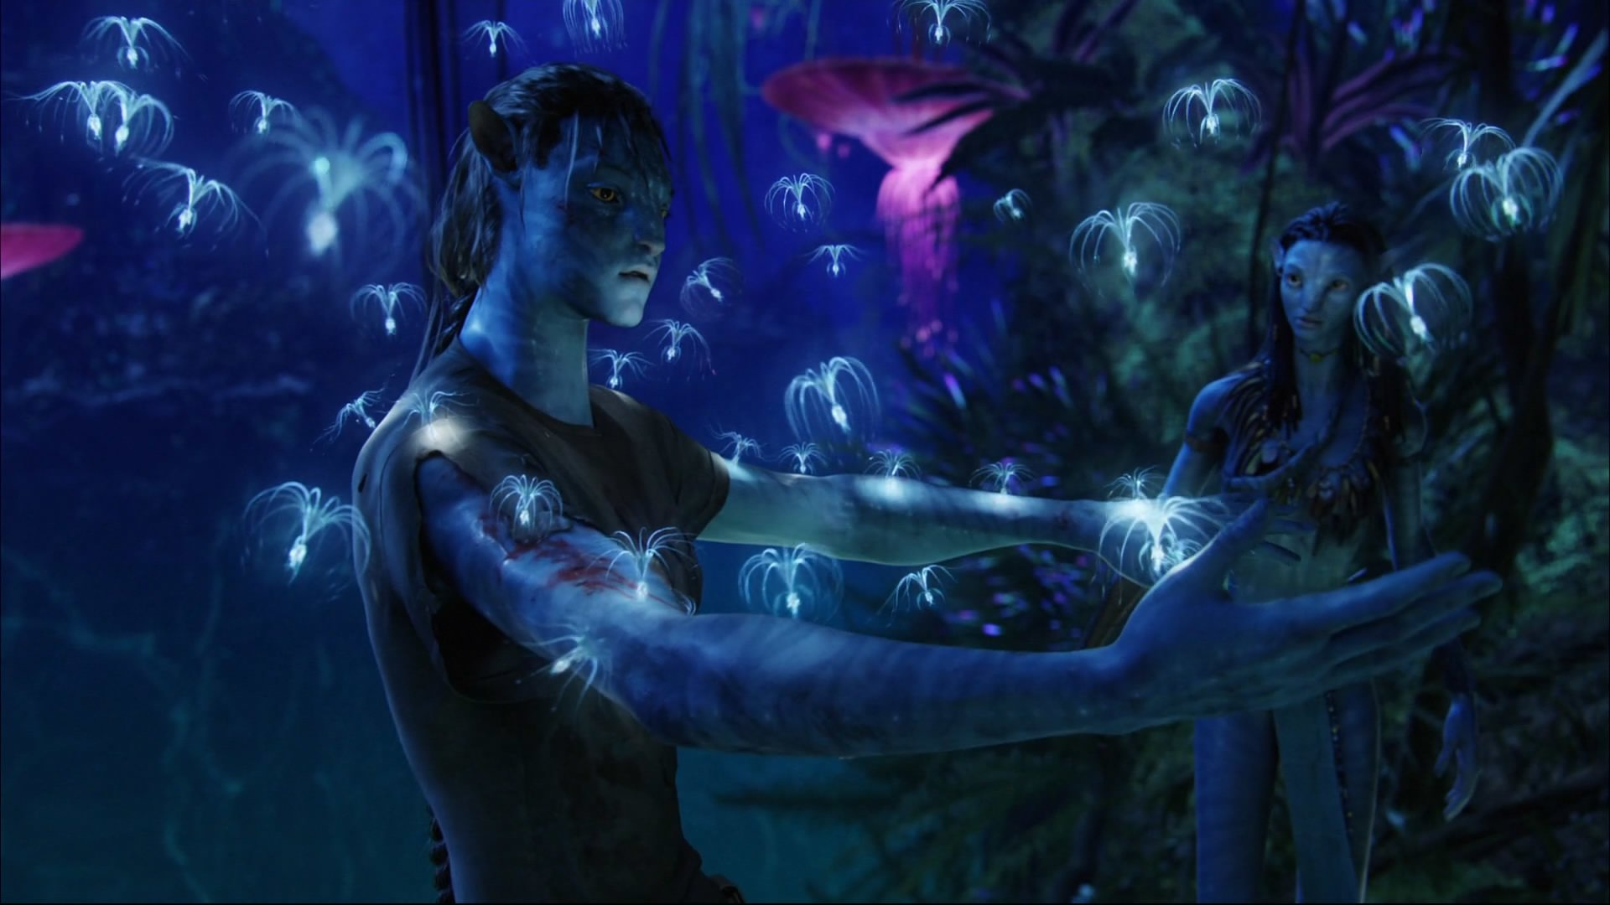
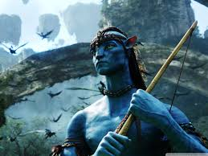
Have you ever seen Avatar – James Cameron's film? There you can see an amazing nature, magic plants and trees and unusual people. Avatars -fantastic men- fight for their home, which is nature.

Slide 16
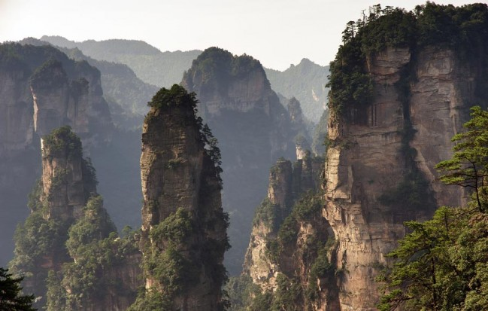
But you think, that only in film you can see amazing nature?
It's not true !
Avatar was inspired by mountains Qiankunzhu in China.

Slide 17
Do you know this man?
Of course, everyone knows him. But what does the Pope have to do with nature?

Slide 18
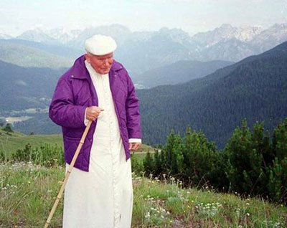
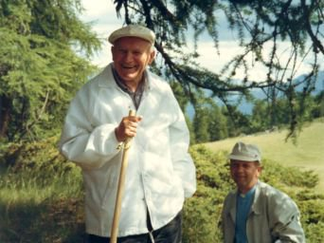
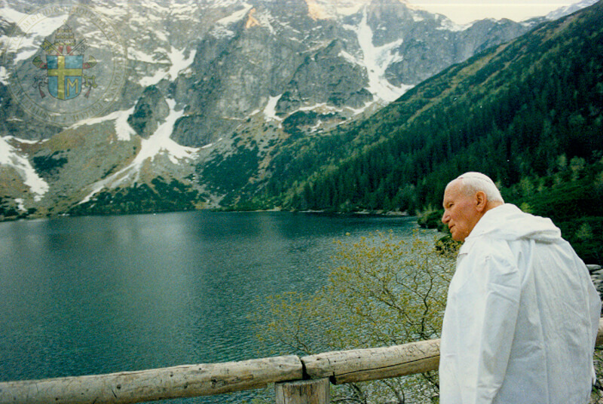
John Paul II loved nature. He often climbed mountains. Tatras, Pieniny, Bieszczady – main aims our compatriot.
''We can pray perfectly when we are out in the mountains or on a lake and we feel at one with nature. Nature speaks for us or rather speaks to us. We pray perfectly.''
John Paul II

Slide 19
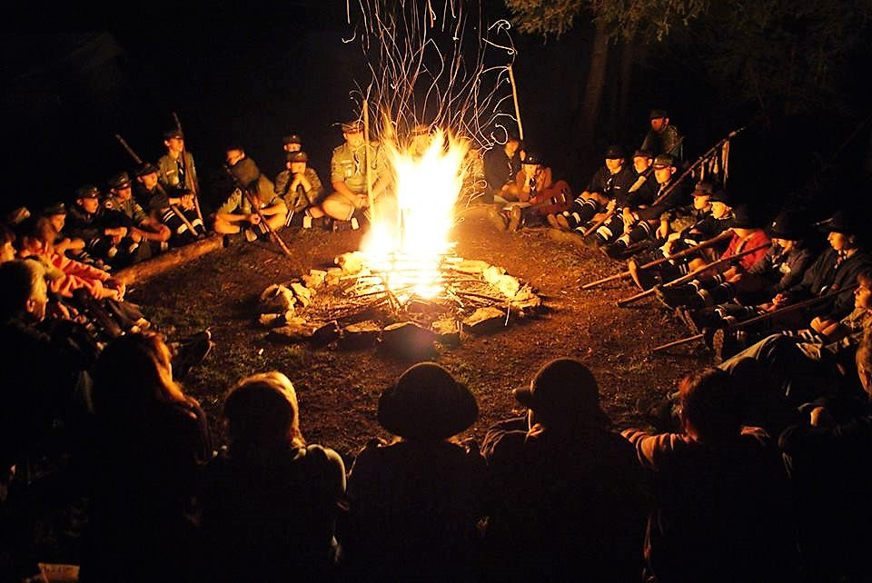
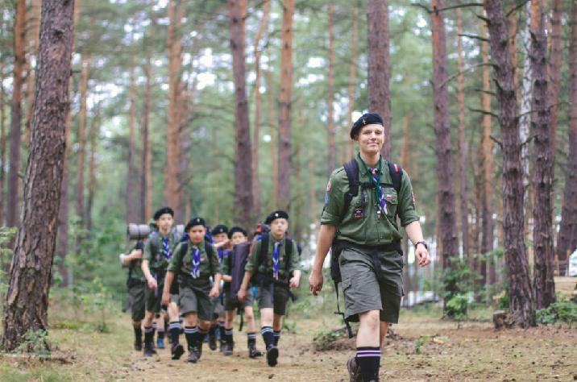
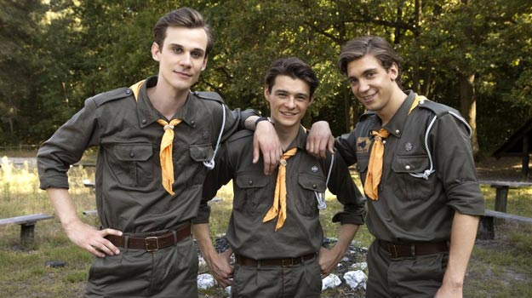
Nobody is as much connected to nature as scouts who go to camps and for a few weeks live together with nature in difficult conditions without any technology.

Slide 20
Do you think that nature is only to admire ?
SO NO
Many times the herbs that we got of nature, they saved our lives.

Slide 21
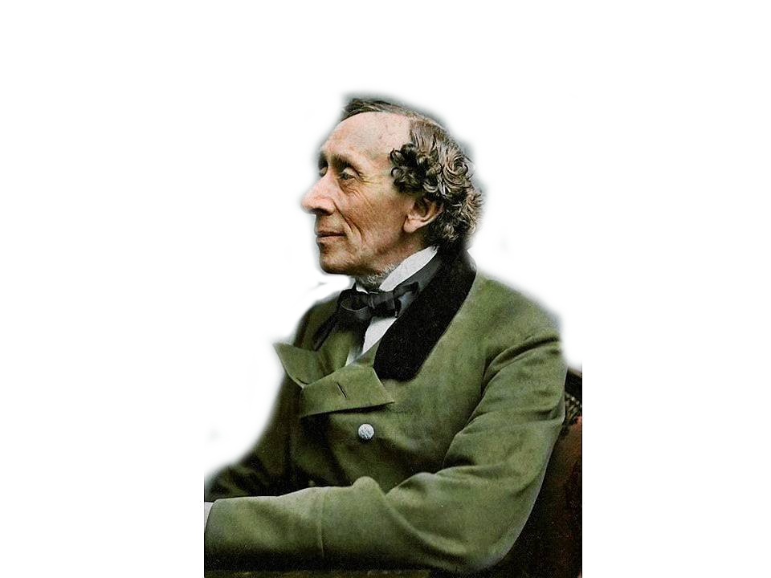
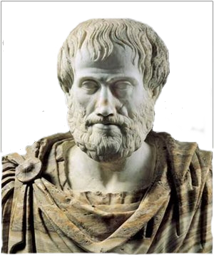
And finally, a few words of famous people
"If you truly love nature, you will find beauty everywhere."
Vincent van Gogh
''Just living is not enough...one must have sunshine, freedom, and a little flower.''
Hans Christian Andersen
''Nature does nothing uselessly.''
Aristotle

Slide 22
But if you really want to understand nature, you have to:
1) leave everything
2) go outside
3) and take a deep breath
and then
, everything will be better ☺

Slide 23
Thanks for watching ☺
Presentation by:
Aleksandra Sadowska
Paulina Janac
Karolina Sierżęga
class III gimnazjum
Zespół Szkół w Strażowie
Teacher: Magdalena Bartochowska

Slide 24
SOURCES
www.mamadziecismieci.blogspot.com
www.myloview.pl
www.naTatry.pl
www.niedziela.pl
www.oltympia.gr
www.pinterest.com
www.pixers.pl
www.przeglad-turystyczny.pl
www.reygif.com
www.smakchwil.com
www.tapeciarnia.pl
www.tapetynapulpit.pl
www.thumb.pl
www.tvp.pl
www.urzadzamy.pl
www.wallpaperabyss.pl
www.wallpaperswide.pl
www.wyborcza.pl
www.wyprawaznaturaikultura.com
Www.youtube.com
www.zsdomaniew.pl
www.academy.cu
www.akademiasmyka.pl
www.bigpoint.com
www.canstockphoto.com
www.classroomclipart.com
www.colourbox.dk
www.cotoznaczy.com
www.deon.pl
www.e-gory.pl
www.emoji.co.uk
www.emojiisland.com
www.giphy.com
www.gminakonopiska.pl
www.graphicriver.net
www.greensolutions.pl
www.iconscout.com
www.imagnesemgifts.com
www.ipsb.nina.pl
www.KinYu-Z.net
www.m.gifmania.com
www.bushcraft.com

