Slide 1
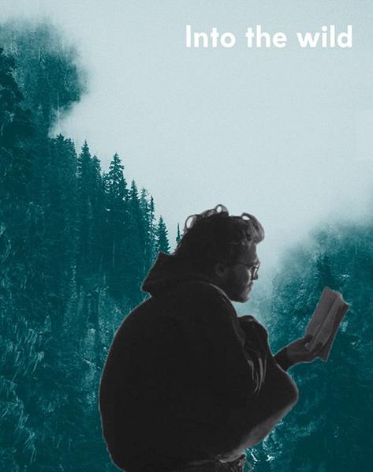

Awesome friendship beetwen a human and nature, which doesn’t always bring benefits.

Slide 2
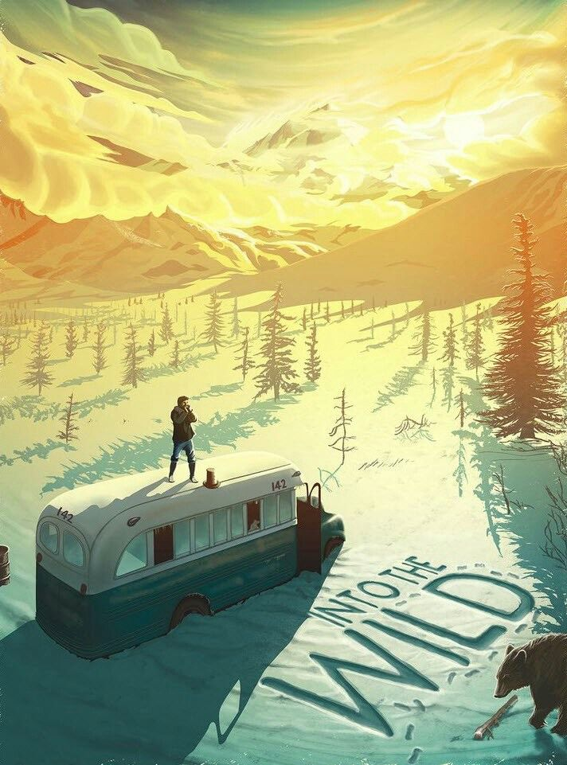
The most important information
The film is an adaptation of Jon Krakauer's book of the same title, released in 1996. The story is based on the travels of Christopher McCandless across North America and his experiences in the Alaskan wilderness in the early 1990s.
Release date: 21 September 2007
Country of production: United States
Kind: Drama, biographical movie
Language: English
Director: Sean Justin Penn

Slide 3
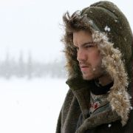
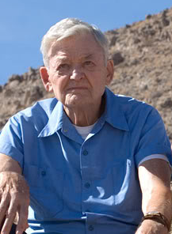
Starring
Christopher McCandless
Ron Franz
Emile Hirsch
Hal Holbrook

Slide 4
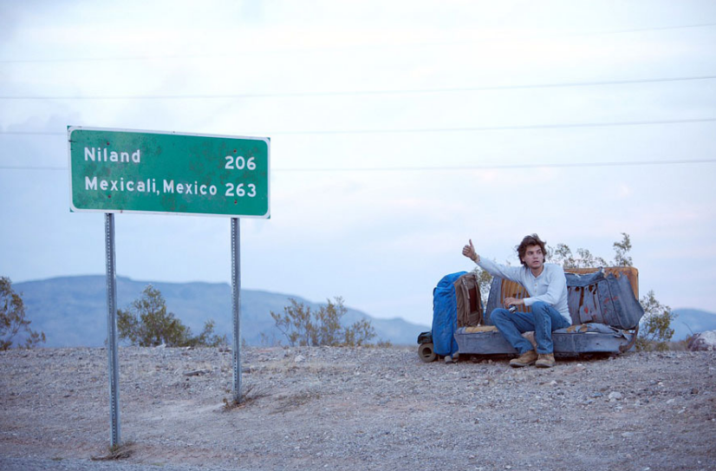
Can a human long for lost reliationship with nature? Can a human drop out off money, career, society and choose freedom, wilderness, uncontrollable liberty? And finally- can a human survive unaided, only with nature?

Slide 5
A promising 22-year old boy from a rich American family, decided to run away from home. For Christopher, escape from home was a conscious break with his life and his first step to his final goal, the journey into the wilderness of Alaska.

Slide 6
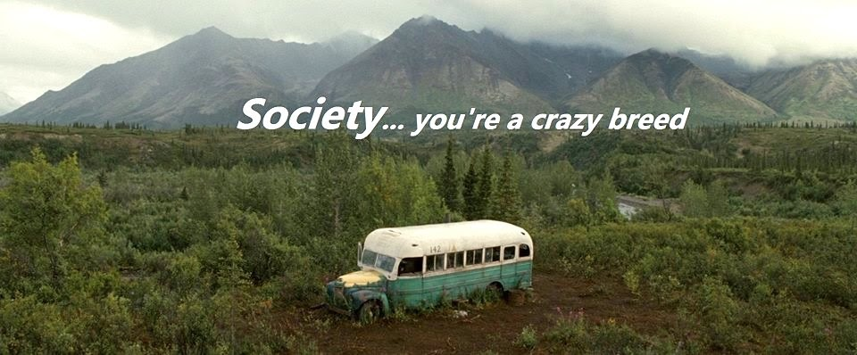
He changed his name to Alexander Supertramp and began a great adventure. It expressed opposition to the rules of functioning of today's society.

Slide 7
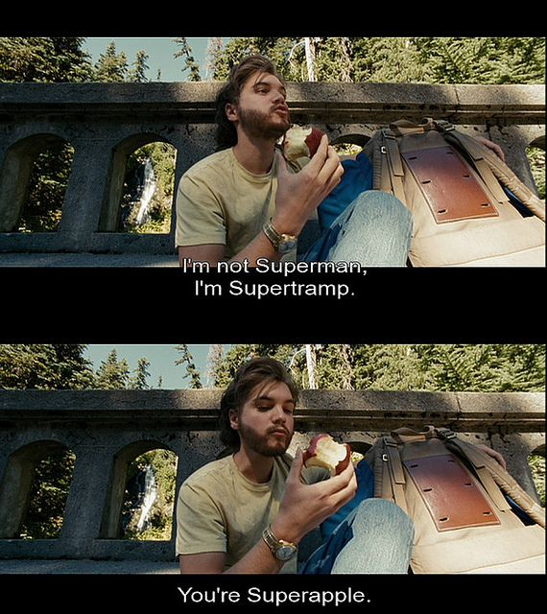

Slide 8
He was fascinated by the prose of London, Tolstoy, Thoreau. Life in harmony with nature was above ubiquitous consumerism.

Slide 9
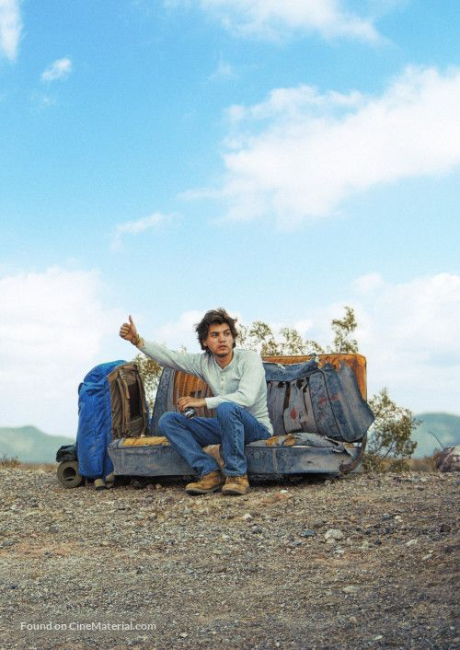
McCandless traveled with his beloved car, but after some time he abandoned it, left the keys in the clipboard and continued hitchhiking in an unknown direction.

Slide 10
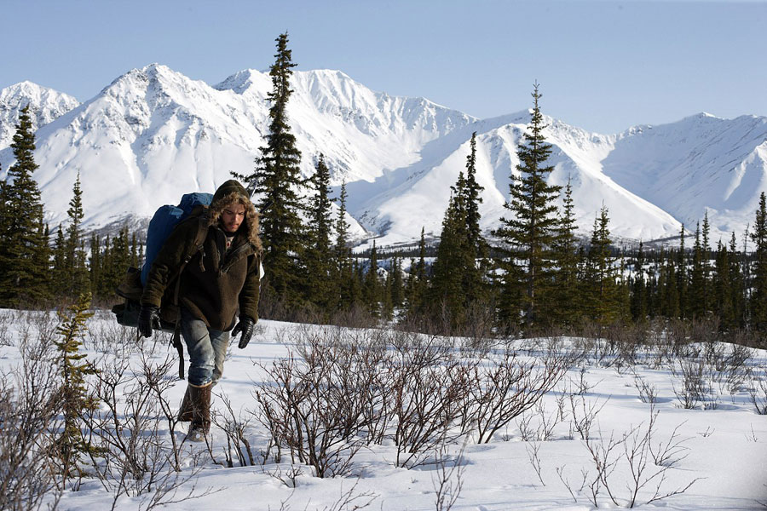
Chris went to Alaska with no equipment, no clothes, no preparation and no map. He didn’t have minimal knowledge about how to eat and how to survive in these conditions. He risked his life to make his dreams come true.

Slide 11
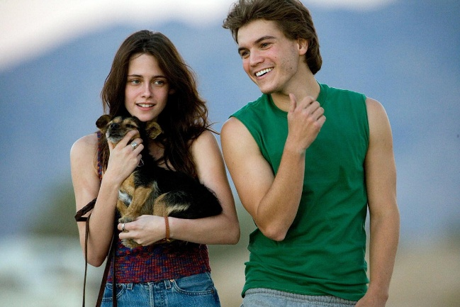
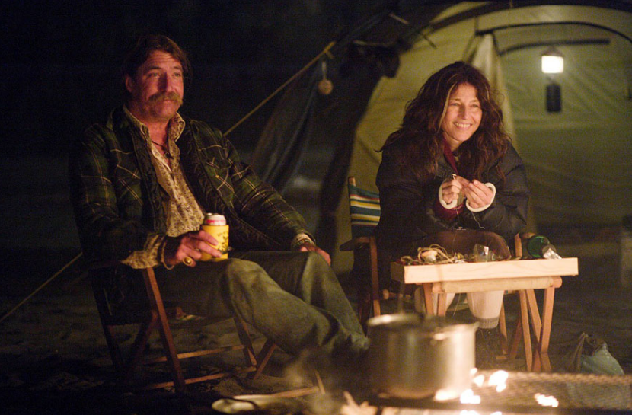
During this trip, Chris met many interesting people, who helped him reach his destination.

Slide 12
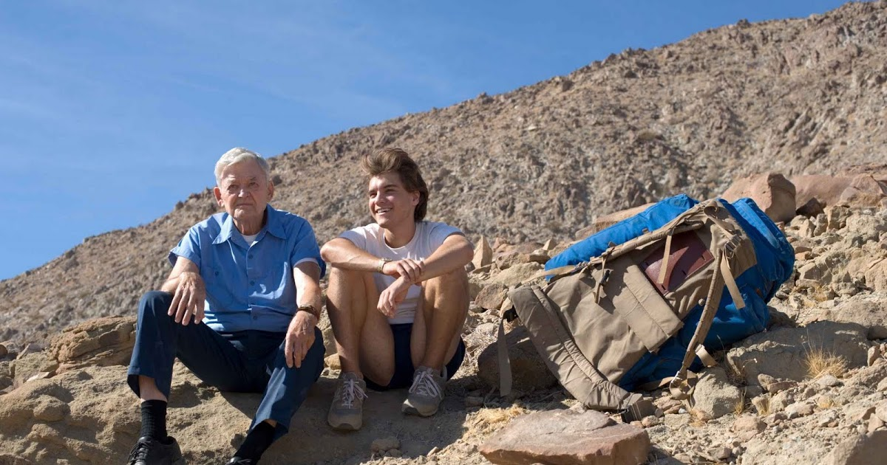
He made friends with Ron Franz , who allowed him to live at his home. Thanks to his help, the old man climbed to the top of the mountain and saw a beautiful landscape, which was impossible, before he met the boy.

Slide 13
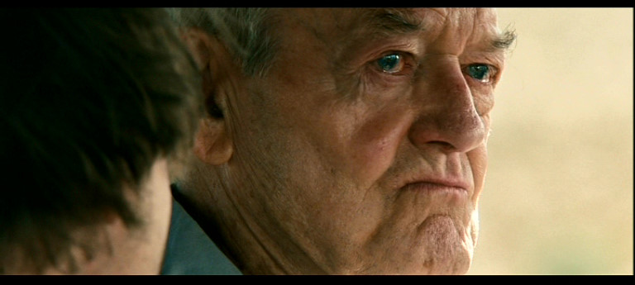
Ron asked him, does he want to be adopted. Chris promised him, that he would answer his question after returning from the Alaska.

Slide 14
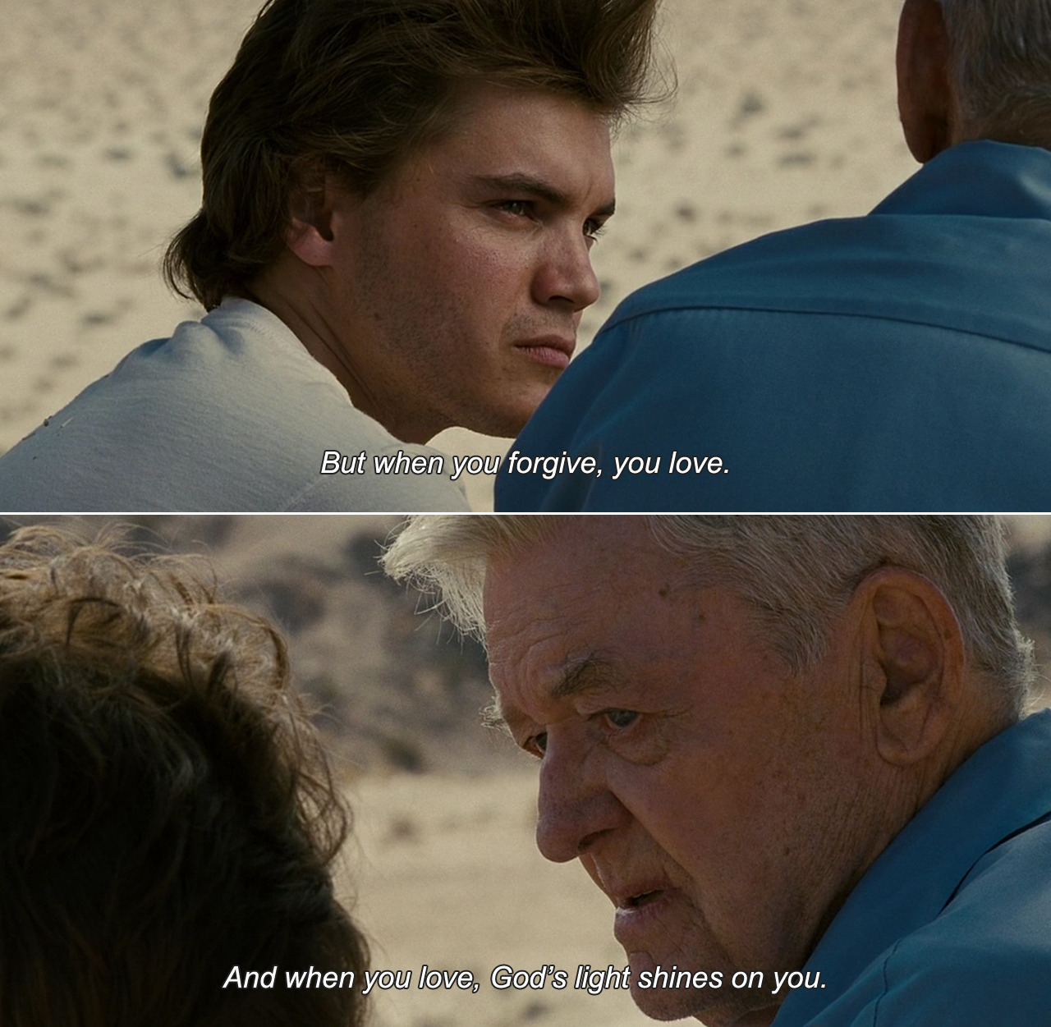

Slide 15
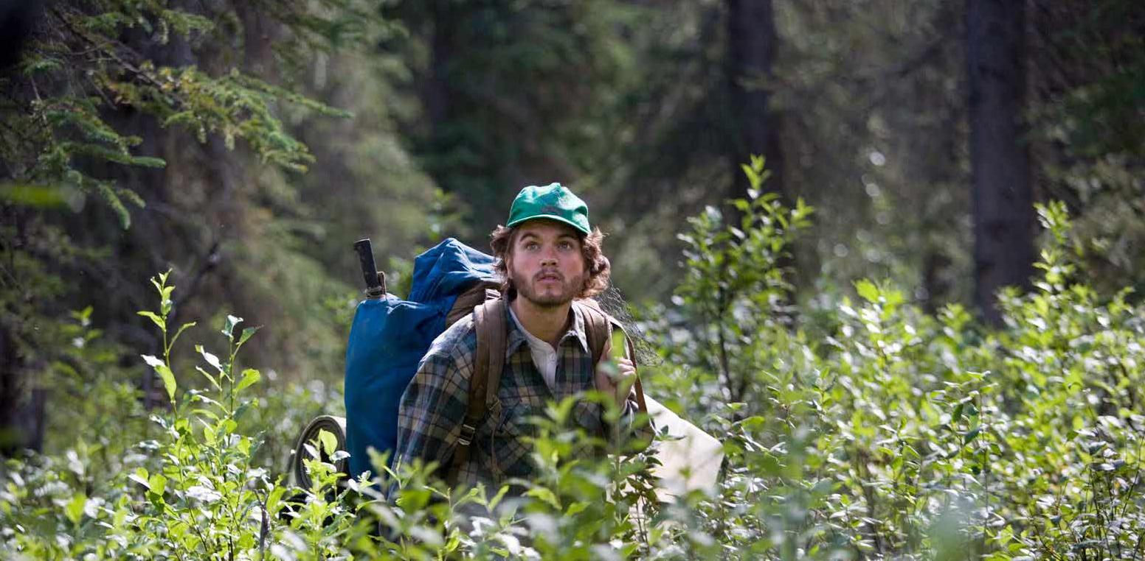
During the one of the expeditions for food, he mistook the fruit and ate poisonous berries.

Slide 16
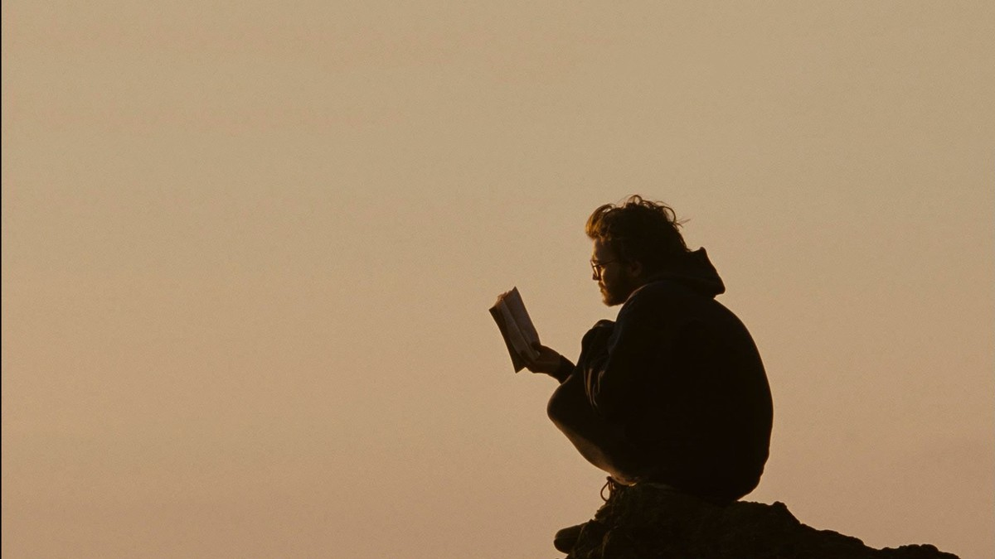
In early July, he decided to leave the wilderness and come back to home. He realized, that happiness is only real, when shared.

Slide 17
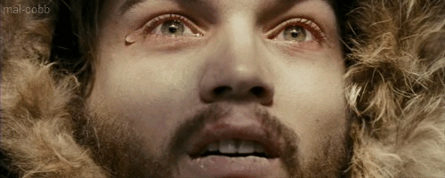
Despite his effort, he didn’t fly to return home. He felt, that he was losing strength and after a few days he died.

Slide 18
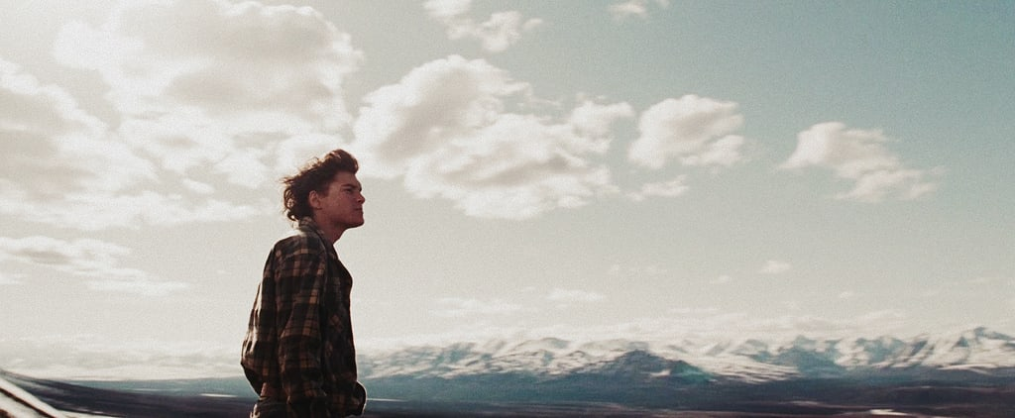
„Into the wild” is a story about searching for yourself, about striving for freedom, and getting out of the schemes.
The boy wanted to feel unity with nature, but he forgot completely what nature can be, and that in principle it is always dangerous.

Slide 19
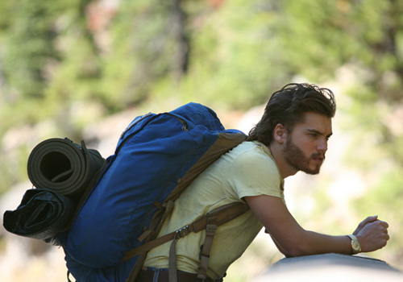
The wild nature of Alaska is shown by the director in a very realistic way, not limited only to the nice images of deer in the forest. Using the example of Christopher's story, he shows, that wilderness isn’t a place for enthusiastic young people, whose entire knowledge of survival comes from books.

Slide 20
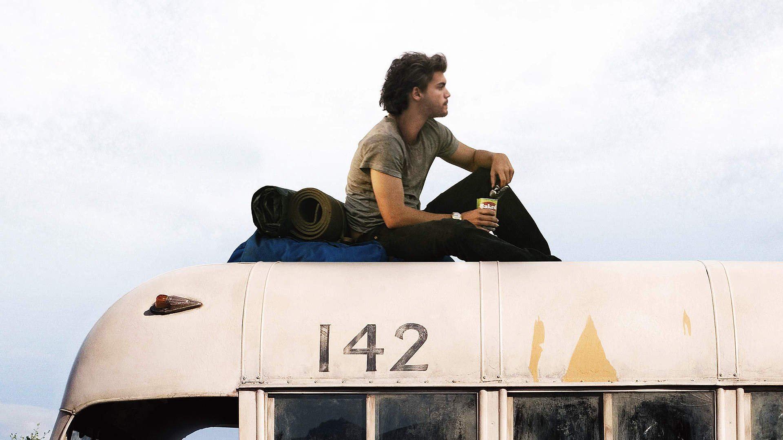
THANKS FOR WATCHING!

Slide 21
Prepared by Wiktoria Pasierb and Asia Machno
School: Szkoła Podstawowa w Palikówce
Class: III grade, junior high school
Teacher: Kornelia Cop

Slide 22
Sources of information:
Sources of graphic:
https://en.wikipedia.org/wiki/Into_the_Wild
http://www.filmweb.pl/Wszystko.Za.Zycie
http://paradoks.net.pl/read/6907-wszystko-za-zycie-recenzja
https://www.google.pl/search?q=into+the+wild&source=lnms&tbm=isch&sa=X&ved=0ahUKEwiFuufj9OTaAhWIKewKHX5hCt8Q_AUICigB&biw=1600&bih=745
http://magiaksiazki.blogspot.com/2011/02/jon-krakauer-wszystko-za-zycie.html
https://www.telemagazyn.pl/artykuly/wszystko-za-zycie-ucieczka-od-cywilizacji-recenzja-55701.html
The project was based on a book „Into the Wild”
by Jon Krakauer. Publication date: 1996.

